Slide 1


B2Bi Basics eLearning
Message Processing Part 5
B2Bi Basics
Notes:
Welcome to module 5 for Message Processing, where we will show inbound EDI handling.

Slide 2

Learning Objectives & Introduction
B2Bi Basics: Message Processing Part 5
B2Bi Basics
Notes:
As usual, let’s go through the items and learning objectives for this chapter.

Slide 3
Message Processing Part 5 – Overview
Items
EDI Splitting
EDI Acknowledgements
Bypass EDI Processing
Notes:
When talking about inbound EDI handling, items include EDI Splitting, Acknowledgements and Bypassing the EDI Processing.

Slide 4
Module Objectives
After completing this module, you will have basic knowledge around EDI and how inbound EDI handling works in B2Bi
Notes:
When you finish this module, you will have basic EDI knowledge and will be able to set up EDI handling in B2Bi.

Slide 5
Introduction to EDI Concepts & Structure
B2Bi Basics: Message Processing Part 5
B2Bi Basics

Slide 6
EDI Concepts
Electronic Data Interchange (EDI) is a system that allows document information to be exchanged between businesses, government structures and other entities.
Developed in the United States in the mid-1960s by the Transportation Data coordination Committee (TDCC).
In 1975, the first TDCC standard was published.
1960s
Since the early 1970s, some industries started to work with EDI, such as transportation, pharmaceuticals, automotive and banking. Each sector developed its own set of data elements and messages to meet its needs.
1978 the TDCC was renamed to the Electronic Data Interchange Association (EDIA) and later became the ANSI ASC X12 group which gradually extended and replaced those formats created by the TDCC. European development of TRADACOMS, ODETTE and JEDI started around 1984.
In 1985, work started on EDIFACT (EDI for Administration, Commerce & Transport), an international standard published by the predecessors of the United Nations.
Notes:
The Electronic Data Interchange is a system that allows document information to be exchanged between businesses, government structures and other entities.
It was developed in the mid sixties by the Transport Data Coordination Committee and adopted since the early seventies by various industries, like transport, pharmaceuticals, automotive and banking, where each sector has contributed to the standards over time.
In the mid eighties, EDIFACT was developed as an international standard, published by the predecessors of the UN.

Slide 7
EDI Structure
Transaction
Functional Group
Transaction
Transaction
Interchange
Transaction
Functional Group
Transaction
Transaction
Interchange, containing:
partner’s unique identification ID data
reference number to identify the envelope
date at which the message has been sent
Functional Groups (not mandatory in EDIFACT), containing:
partners unique identification ID data
reference number to identify the functional groups
data information (e.g.: type of message available in the functional groups)
Transaction, containing:
reference numbers to identify the transaction
‘real’ business data
Notes:
In an EDI structure you will find three different layers:
Interchange.
Functional groups.
Transactions.
An interchange can contain multiple functional groups, and functional groups can contain multiple transactions.
An interchange, also known as an envelope, contains data about the partners who exchange messages, a unique ID for the envelope, date, and time.
A functional group, which is optional, contains a unique ID for the functional group and the type of message or transactions which build the group.
A transaction contains the real business data which can be an order, invoice, packing slip, carrier status, etcetera.

Slide 8
Acknowledgement – Layers Overview
Application Acknowledgment
(ORDERS -> ORDRSP)
(APERAK)
(850 -> 855)
-----------------------
Functional (Syntax) Acknowledgement
(CONTRL, 997)
-----------------------Communication Acknowledgment
(protocol specific)
Application Acknowledgment
(ORDERS -> ORDRSP)
(APERAK)
(850 -> 855)
-----------------------
Functional (Syntax) Acknowledgement
(CONTRL, 997)
-----------------------Communication Acknowledgment
(protocol specific)
B2Bi
Trading Partners
Communication Channel
Notes:
When talking about acknowledgements, we see acknowledgements on different levels, going from bottom to top:
On the communication level, where you can have TCP acknowledgement on a very low level, or acknowledgement as an MDN on an AS/2 communication level.
On the functional level, where an EDIFACT control or “ANSI” X12 997 contains information about the message structure or syntax validity.
And on the application level, where you can receive an Order Response as a response to an earlier sent Order or receive an APERAK. The message response to a previously sent message depends on what was agreed upon between the two business partners.

Slide 9
EDIFACT
B2Bi Basics: Message Processing Part 5
B2Bi Basics
Notes:
Now let‘s go into details, starting with EDIFACT.

Slide 10
Acknowledgement for Outbound EDIFACT Messages
On the enveloping tab of the Outbound Agreement, you can request an Acknowledgement from the Partner.
If you Expect an acknowledgement, set the Timeout Period, which is the time that you will wait for an Acknowledgement.
When you expect an Acknowledgement, one of three things will happen.
Positive CONTRL message arrives
Negative CONTRL message arrives
No CONTRL message arrives with in the timeout period
The result of the Acknowledgement processing is available in the Message Log.
Notes:
In the case of outbound EDIFACT messages, you can Request an Acknowledgement as a response to your message sent to a partner. This is a functional acknowledgement, which means that the receiver received and understood the message per EDIFACT standards.
When an acknowledgement is expected, you can set a timeout which specifies the time you will wait for the Acknowledgement.
When an Acknowledgement is expected, three different scenarios may occur:
A positive control message arrives.
A negative control message arrives.
No control message arrives, and you will face a timeout.
The result of Acknowledgement processing is visible both in the Message Log and Message Tracker.

Slide 11
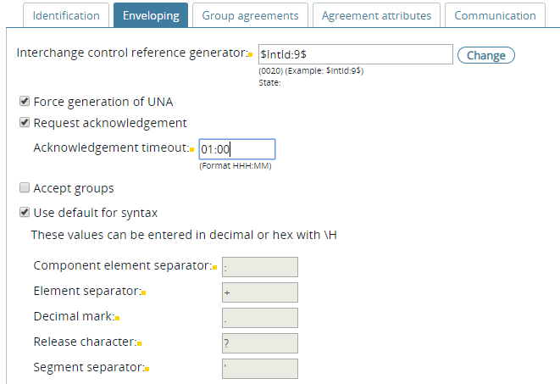
Request Acknowledgement EDIFACT
Request acknowledgement
Timeout period
Notes:
In the configuration of outbound EDIFACT, in the enveloping tab, you can configure the request to receive acknowledgement and the timeout to wait for Acknowledgement.

Slide 12
Acknowledgement Processing for Inbound EDIFACT Messages
When and how to generate Acknowledgements is defined on the Inbound tab of the Inbound Agreement:
Criteria: when to create acknowledgement
Type: Which type of Acknowledgement
Specify Delivery Exchange
Use alternate Delivery Partner
Use a Service for Acknowledgement processing
Agreement for enveloping the acknowledgement
Notes:
On the Inbound tab of the Inbound agreement, we configure when and how to generate an acknowledgement. This is done based on some variables:
The criteria to decide when to create the acknowledgement.
Which type of acknowledgement is generated.
Which delivery exchange is used to send the acknowledgement.
An alternate delivery partner. <break time=“1s" />
Sometimes, you need to use a service to do the acknowledgement processing. For example, when a D93A control is generated but your partner requests to alter some of the values in the message.
And how to collect the acknowledgements in an outbound agreement: most of the time an outbound agreement is used also for other outbound messages sent to the partner involved.

Slide 13
Acknowledgement Processing for Inbound EDIFACT Messages
Criteria is called Generate Acknowledgement Rule.
The possible values are:
On Request – Create CONTRL message when requested (UNB 0029)
Always – Always create CONTRL message
If Error – Create CONTRL message if the syntax validation finds an error
Never – Don’t acknowledge the incoming EDIFACT Interchange
NOTE: Syntax validation is part of executing the map. If there is no map, only the headers will be validated.
Notes:
The criteria to generate a control are based on certain rules:<break time="1s" />
On request, when requested in the UNB element zero zero two nine. <break time="1s" />
Always create a control message. <break time="1s" />
Only if a syntax validation finds an error. <break time="1s" />
Or never create a control message. <break time="1s" />
As syntax validation for EDI documents is part of acknowledgement generation, the document should be matched to a mapping. If there is no validation in a mapping, only the header is validated.

Slide 14
Acknowledgement Processing for Inbound EDIFACT Messages
When an EDIFACT acknowledgement will be created based on the criteria, select the Type of CONTRL message from a dropdown list.
The available types are:
EANCOM D93A
EANCOM D96A
UN EDIEL Version 2
UN Version 2.x, 3 and 4
EDG@S 3.2 and 4
Select Type of CONTRL message to generate
Notes:
In case a control message generation takes place, you can choose between different types of control messages to generate:<break time=“.5s" />
EANCOM D93A. <break time=“.5s" />
EANCOM D96A. <break time=“.5s" />
UN EDIEL Version 2. <break time=“.5s" />
UN Version 2, 3 and 4. <break time=“.5s" />
EDIGAS 3.2 and 4. <break time=“.5s" />

Slide 15
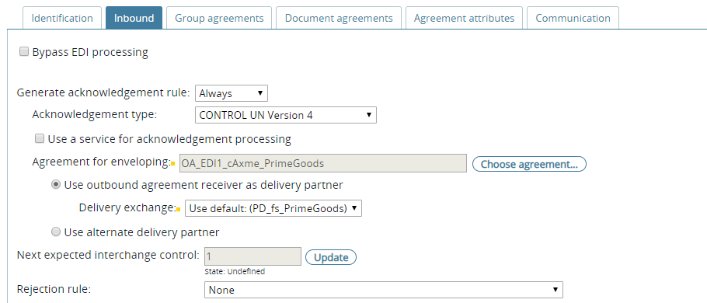
Acknowledgement Processing for Inbound EDIFACT Messages
Criteria
Type
Use a Service
Select agreement to use for enveloping the CONTRL message
Delivery Exchange
Send 997 to a different partner
Notes:
When configuring the inbound EDIFACT, you can set the criteria form acknowledgement generation, in this case set to always.
An acknowledgement of type control UN Version 4 is generated.
It is not processed via a service as the checkbox is unticked, and no service is selected.
It is added to an outbound agreement enveloping.
After enveloping the default delivery exchange for Primegoods will be used to deliver the envelope, including the acknowledgements.
No alternative partner is configured to get the envelope delivered.

Slide 16
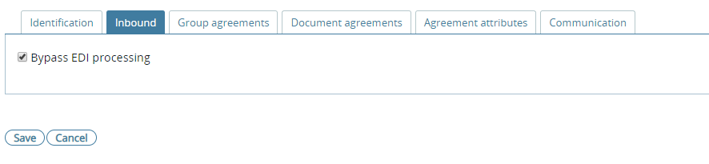
Acknowledgement Processing for Inbound EDIFACT Messages
To disable the acknowledgement processing select Bypass EDI processing.
Notes:
And to bypass EDI processing and still forward the envelope including header and documents to application side, just use the “Bypass EDI processing” checkbox.

Slide 17
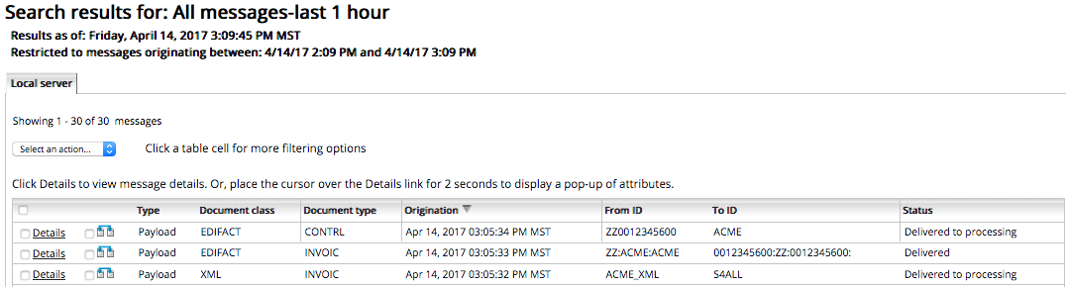
Monitor Acknowledgements
Message that originates in the TE can be monitored in the Message Tracker.
For incoming messages, the status is “Delivered to Processing”.
For outgoing messages, the status is “Delivered”.
XML form Backend
INVOIC to Trading Partner
CONTRL from Trading Partner
Monitoring in the Message Tracker, Outbound EDIFACT
Notes:
In message tracker, you can follow outbound EDIFACT processing by adding a document class and a document type to the view.
When the initial pickup is set to standard, you will see the ”delivered to processing” status in the message tracker.
In that case, messages are processed by the integration engine.
For messages with the status Delivered, the messages have been delivered to a partner or application.

Slide 18
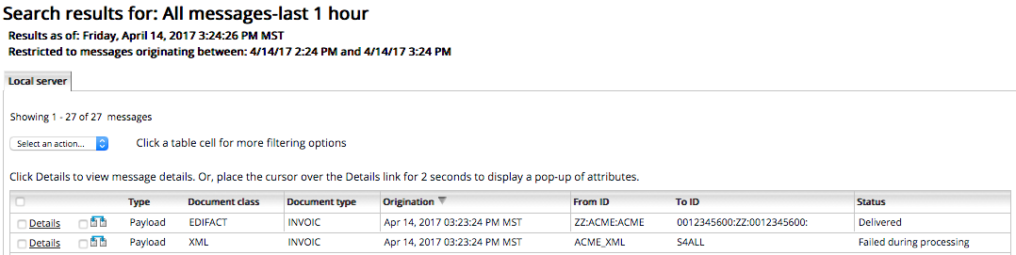
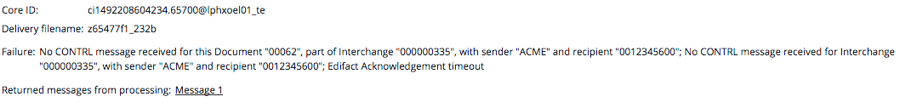
Monitor Acknowledgements
Missing CONTRL
Notes:
In case the option is set to expect acknowledgement, it is expected within the specified timeframe.
In case no acknowledgement is received, you will see a failure during processing, where the detail will point out the acknowledgement timeout.

Slide 19
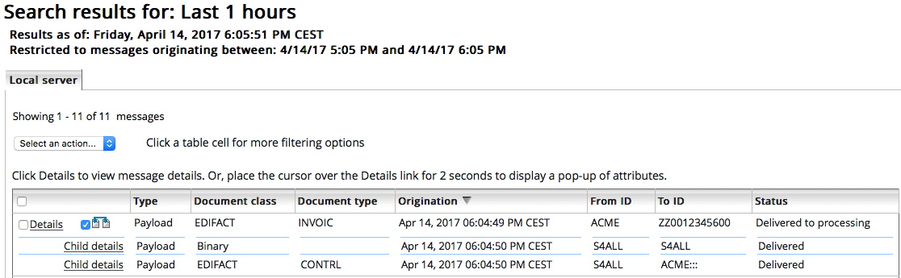
Monitor Acknowledgements
Monitoring in the Message Tracker, Inbound EDIFACT.
INVOIC from Partner
In-house to Backend
CONTRL to Partner
Notes:
In case of “Acknowledgement always”, it will look as shown in this screenshot.
An inbound EDIFACT INVOICE message sent by acme is delivered to processing, resulting in two outputs: a binary transfer to a back-office system and an EDIFACT control message returned to the partner acme.
In Message Tracker, you can see the parent-child relation of the entries when checking the details.

Slide 20
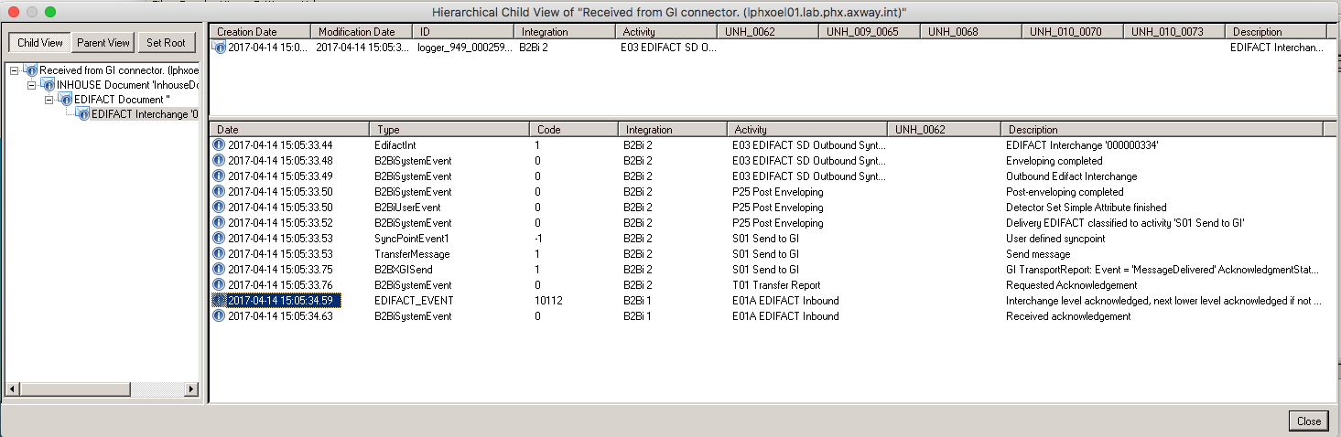
Monitor Acknowledgements
In the Message Log there is detailed tracking of the Hierarchy of each message.
You can see the incoming message, the resulting outgoing message, the Acknowledgement, and all the intermediate messages.
Monitor in the Message Log
Notes:
The acknowledgement tracing can also be done in Message Log as shown in this example.
On the left, you see an inhouse message arriving in the integration engine via the connector which hands over the Message from Trading engine to Integration engine.
The message is converted from Inhouse to EDIFACT.
In the lower right part, we see the enveloping is finished at some stage, and after enveloping some attributes are set.
The message is sent and almost instantly – within less than a second – the acknowledgement is received.

Slide 21
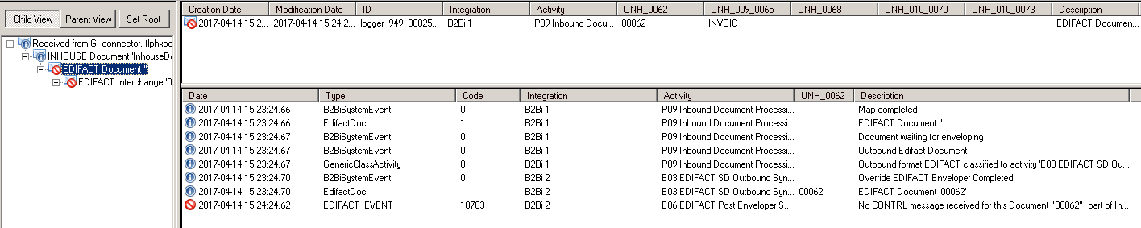
Monitor Acknowledgements
For outbound EDIFACT, the Interchange and the Documents remain in Active state until B2Bi receives the acknowledgement.
If the acknowledgement does not arrive within the configured timeout period. The Interchange and the Documents event change severity to ERROR.
Monitor in the Message Log
Notes:
Here you see that the message gets into an error state since no control was received for the document with ID 00062.
It looks like the timeout for acknowledgement receipt was set to 1 minute in this case.

Slide 22
Rejection Rules
Related Documents or Transactions sets from the same Interchange can be rejected based on several criteria:
None – Don’t reject any correct Documents or Transaction sets
If any document is stopped, reject entire Interchange.
If any document is stopped, reject messages of the same type.
If any document is stopped, reject specific type of messages.
These message types may be added in a comma separated list in the “Custom rules” field.
The Rejection rule influences the acknowledgement generation.
Reject related Documents/Transaction sets
Notes:
In the rejection rules, several options are available:
You can specify to do nothing.
Reject the complete interchange.
Reject only messages of the same type as the one running into error.
Or reject documents of certain types specified in custom rules.
Rejection rules have an impact on acknowledgement generation.
Most of the time this option is used in line with the acknowledgement generation set to “If errors”.

Slide 23
X12
B2Bi Basics: Message Processing Part 5
B2Bi Basics
Notes:
Now let’s have a look at the same processes and characteristics for ANSI X12 messages.

Slide 24
Acknowledgements for Outbound X12 Messages
In case an acknowledgement is expected:
On the enveloping tab of the Outbound Agreement, you can set the Timeout Period, which is the time that you will wait for an Acknowledgement.
When you expect an Acknowledgement, one of three things will happen:
Positive 997 message arrives
Negative 997 message arrives
No 997 message arrives within the timeout period
The result of the Acknowledgement processing is available in the Message Log.
Notes:
For outbound X12 messages, you can request Acknowledgements for the messages sent to a partner.
In case an Acknowledge is expected, you can specify a timeout which defines the timeframe to wait for the Acknowledgement.
In case an Acknowledgement is expected, we again see the three possible scenarios:
A positive nine nine seven message arrives. <break time="1s" />
A negative nine nine seven message arrives. <break time="1s" />
No nine nine seven message arrives, and you will face a timeout.
The result of the Acknowledgement processing is visible both in the Message Log and Message Tracker.

Slide 25
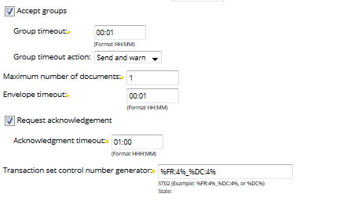
Request Acknowledgement X12
Expect acknowledgement (997). You can’t request acks in X12.
Timeout period
Notes:
In the configuration of outbound X12, in the enveloping tab, you can configure the request to receive acknowledgement and the timeout to wait for acknowledgement.

Slide 26
Acknowledgement Processing for Inbound X12 Messages
When and how to generate Acknowledgements is defined on the Inbound tab of the Inbound Agreement:
Rule: Yes, No, Detail level
Use input Interchange for Identifiers
Specify Delivery Exchange
Use alternate Delivery Partner
Use a Service for Acknowledgement processing
Agreement for enveloping the acknowledgement
Notes:
On the Inbound tab of the Inbound agreement, we configure when and how to generate an acknowledgement. This is done based on some variables, like,<break time="1s" />
* The rule to decide when to create the acknowledgement. <break time=“1s" />
* Which type of acknowledgement is generated. <break time=“1s" />
* Which delivery exchange is used to send the acknowledgement. <break time=“1s" />
* An alternate delivery partner… <break time=“1s" />
* Sometimes, you need to use a service to do the acknowledgement processing. For example, when an D93A control is generated but your partner requests to have some of the values in the message altered. <break time=“1s" />
* And, how to collect the acknowledgements in an outbound agreement. Most of the time, an outbound agreement is used also for other outbound messages sent to the partner involved.

Slide 27
Acknowledgement Generation for X12
Criteria is called Generate Acknowledgement Rule.
The possible values are:
No - Don’t generate a Functional Acknowledgement
Yes, detailed - Generate a detailed Acknowledgement
Yes, non-detailed - Generate a summary Acknowledgement
NOTE: Syntax validation is part of executing the map. If there is no map, only the headers ISA-IEA, GS-GE will be validated.
Notes:
he criteria to generate a 997 are based on the following options:
On request, when requested in the ISA element 0I13.
Always create one.
Only if a syntax validation finds an error.
Or never.
As syntax validation for EDI documents is part of acknowledgement generation, the document should be matched to a mapping. If there is no validation in a mapping, only the header is validated.

Slide 28
Acknowledgement Generation for X12
Use Inbound identifiers
Use Outbound agreement
The Identifiers in the X12 Headers in the Inbound Envelope will be used when enveloping the acknowledgement.
Specify an outbound agreement used for enveloping of the Acknowledgement.
Notes:
The options for Enveloping X12 Acknowledgements are:
Use Inbound identifiers – the Identifiers in the X12 Headers in the Inbound Envelope will be used when enveloping the acknowledgement.
Use Outbound agreement – specify an outbound agreement used for enveloping of the Acknowledgement.

Slide 29
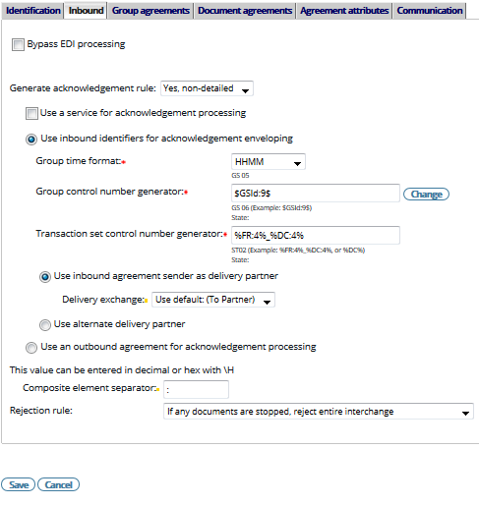
Acknowledgement Processing for Inbound X12 Messages
Rule
Re-use the identifiers from the Inbound Interchange when enveloping the 997
Use a Service
Delivery Exchange
Send 997 to a different partner
Select agreement to use for enveloping of the 997
Notes:
When configuring the inbound X12, you can set the rule form acknowledgment generation.
In this example, it is set to ‘Yes, non-detailed’.
The acknowledgement message is not processed via service as the checkbox is unticked, and no service is selected.
The following inbound identifiers are used for acknowledgment enveloping: Group time format HHMM.
Group control number generator as shown.
And Transaction set control number generator, also as shown.
After enveloping the default delivery exchange of the inbound agreement, sender will be used to deliver the acknowledgement.
No alternate partner is configured to deliver the acknowledgement.
An outbound agreement is NOT used for acknowledgement enveloping, so we utilize the inbound identifiers reversed.
The composite element separator was set to “colon” and the rejection rule “If any documents are stopped, reject the entire interchange” was selected.

Slide 30
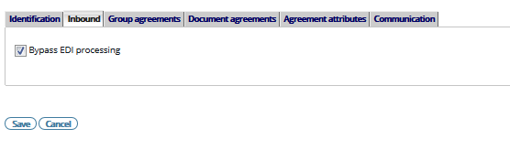
Acknowledgement Processing for Inbound X12 Messages
To disable the acknowledgement processing select Bypass EDI processing.
Notes:
To bypass EDI processing – which means forwarding the envelope including header or documents to the application side – just use the “Bypass EDI processing” checkbox.

Slide 31
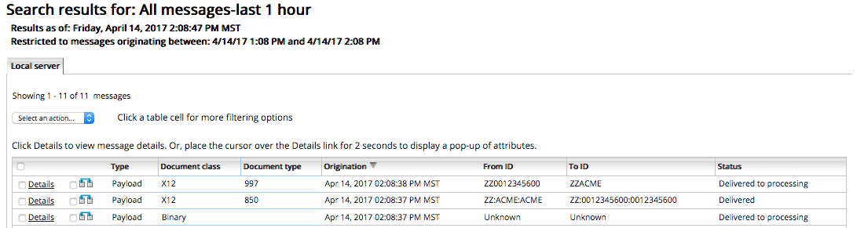
Monitor Acknowledgements
Message that originates in the TE can be monitored in the Message Tracker.
For incoming messages, the status is “Delivered to Processing”.
For the outgoing messages, the status is “Delivered”.
In-house from Backend
X12 850 to Trading Partner
X12 997 from Trading Partner
Monitoring in the Message Tracker, Outbound X12
Notes:
This example shows a corresponding processing in Message Tracker, including an X12 850 purchase order delivery and the receipt of the corresponding X12 nine nine seven acknowledgement.

Slide 32
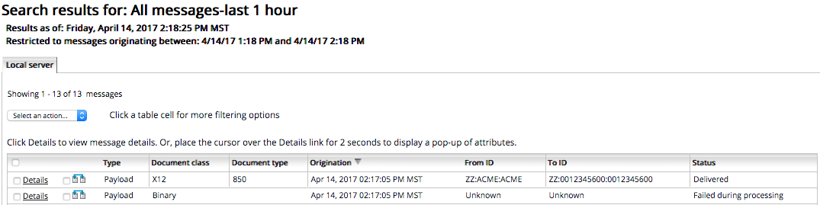
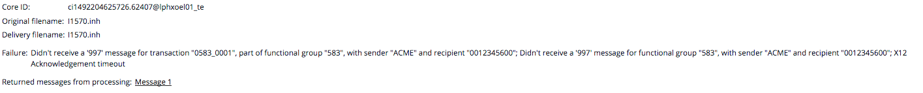
Monitor Acknowledgements
Missing Acknowledgement
Notes:
Here, no corresponding acknowledgment was received within the specified time frame, so the initial transfer was set to Failed during processing, although the message was delivered to the partner.

Slide 33
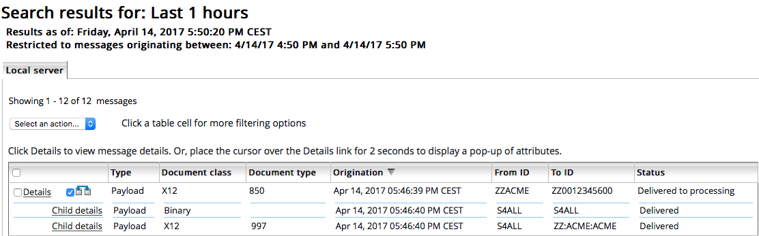
Monitor Acknowledgements
Monitoring in the Message Tracker, Outbound X12.
X12 850 from Partner
In-house to Backend
997 to Partner
Notes:
This example just shows a different view displaying the original transfer from the partner, including its two child transfers: the resulting inhouse message sent to a backend system, and the return of the acknowledgment to the partner.

Slide 34
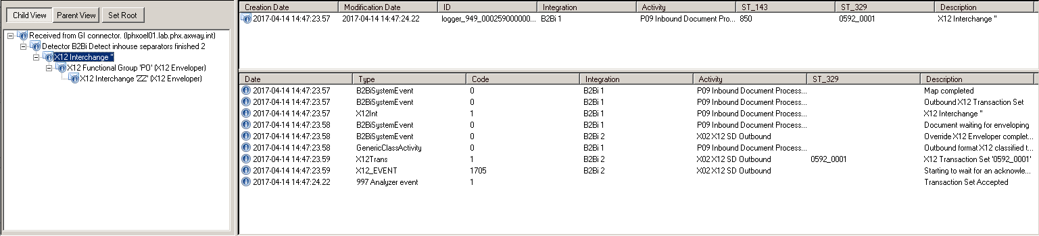
Monitor Acknowledgements
In the Message Log there is detailed tracking of the Hierarchy of each message. You can see the Incoming message, the resulting outgoing message, the Acknowledgement, and all the intermediate messages.
Notes:
In Message Log, an outbound X12 processing may look like this. Here, the connections are visible more clearly due to the tree view on the whole processing.

Slide 35
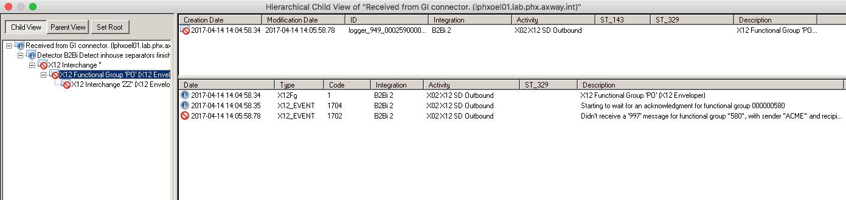
Monitor Acknowledgements
For outbound X12, the Transaction Sets and the Functional Group remains in Active state until B2Bi receives the acknowledgement.
If the acknowledgement does not arrive within the configured timeout period, the Transaction Sets and the Functional Group event change severity to ERROR.
Notes:
In case of outbound flows, the state of the transaction set, as well as of the functional group, is kept active – represented by a yellow star symbol – until either the acknowledgement is received, which turns them to blue, or the timeout specified has been reached, which turns them to red.

Slide 36
Rejection Rules
Related Documents or Transactions sets from the same Interchange can be rejected based on several criteria:
None – Don’t reject any correct Documents or Transaction sets
If any document is stopped, reject entire Interchange.
If any document is stopped, reject messages of the same type.
If any document is stopped, reject specific type of messages.
These message types are a comma separated “Custom rules field.
The Rejection rules influences the acknowledgement generation.
Reject related Documents/Transaction sets
Notes:
In the rejection rule, the same options as for EDIFACT are available:
You can select to do nothing.
Or to reject the complete interchange.
Reject only messages of the same type as the one running into error.
Or reject documents of certain types specified in custom rules.
Rejection rules have an impact on acknowledgement generation. Most of the time this option is used in line with the acknowledgement generation set to “If errors”.

Slide 37
EDI Splitting
B2Bi Basics: Message Processing Part 5
B2Bi Basics
Notes:
Now let‘s have a look into the splitting mechanism for EDIFACT and X12 message packages.

Slide 38
EDI Structure
Transaction
Functional Group
Transaction
Transaction
Interchange
Transaction
Functional Group
Transaction
Transaction
Interchange, containing:
partner’s unique identification ID data
reference number to identify the envelope
date at which the message has been sent
Functional Groups (not mandatory in EDIFACT), containing:
partners unique identification ID data
reference number to identify the functional groups
data information (e.g.: type of message available in the functional groups)
Transaction, containing:
reference numbers to identify the transaction
‘real’ business data
Notes:
Let‘s remember, once again, the EDI structure with its three layers:
The envelope segments containing the sender and recipient identifiers, the reference number of the envelope, date and time of creation etcetera.
The optional functional groups again contain the partner information, this time in line with additional information like the functional group type.
The transaction layer includes the message type, reference numbers to identify the transaction, and the real business data.

Slide 39
EDI Splitting
As part of the processing in B2Bi, EDI files are being split into Interchanges, Functional Groups and Transactions Sets.
This split logic is completely automatic and hidden for the user – the only thing the user has to worry about is the specific processing settings (parameters) that need to apply for a certain partner / set of partners.
Notes:
As part of the processing in B2Bi, EDI files are being split into Interchanges, Functional Groups and Transactions Sets.
This split logic is completely automatic and hidden from the user – the only thing the user must worry about are the specific processing parameters, which apply for a certain partner or set of partners.

Slide 40
Bypass EDI Processing
B2Bi Basics: Message Processing Part 5
B2Bi Basics
Notes:
There is a possibility to bypass this automatic EDI processing. Let‘s take a look.

Slide 41
Bypass EDI Processing
For both EDIFACT and X12, there is the option in B2Bi to bypass the standard EDI processing – this can be set in the “inbound tab” of the Inbound Agreement.
If selected, EDI structures are handled as “non-EDI”.
This implies that the message will not be split but sent as a whole through the service (including the envelope).
As only the beginning of the file is scanned for pattern recognition– if more than one transaction set type is sent in a single envelope, only that first type will be recognized.
No acknowledgement (997/CONTRL) will be generated.
Notes:
This option may be set in the inbound tab of an inbound agreement both for EDIFACT and ANSI X12.
If selected, EDI structures are handled as “non-EDI”.
This implies that the message will not be split but sent as a whole through the service – including the envelope.
Since only the beginning of the file is scanned for pattern recognition, if more than one transaction set type is sent in a single envelope, only that first type will be recognized.
No acknowledgement will be generated as it cannot be linked to a specific transaction of the interchange.

